Slide 1
8. Standard sequential modules
Fondamenti di Elettronica
Sergio Spanò – spano@ing.uniroma2.it

Slide 2
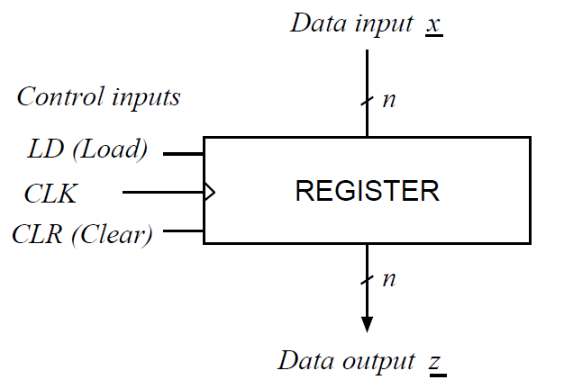
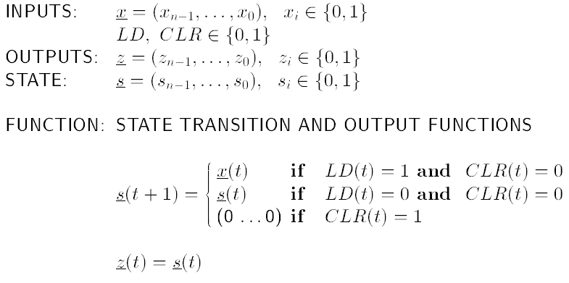
Registers

Slide 3
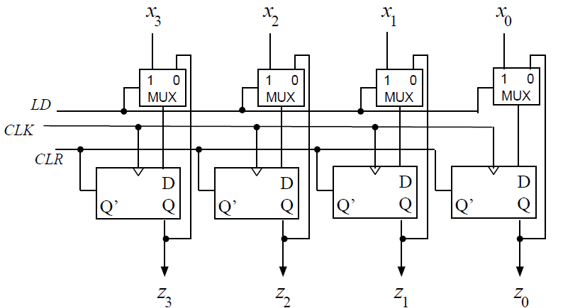
Registers

Slide 4
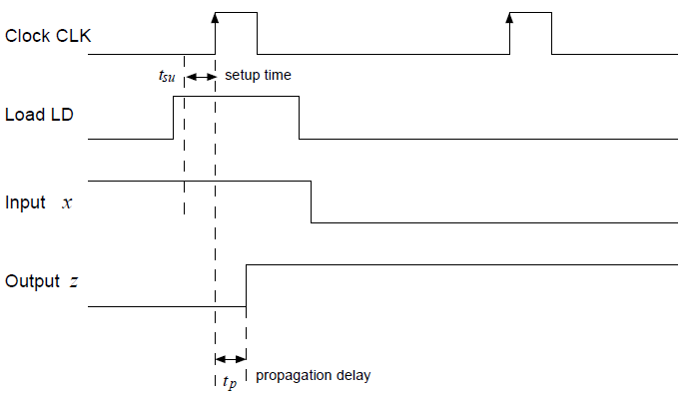
Registers

Slide 5
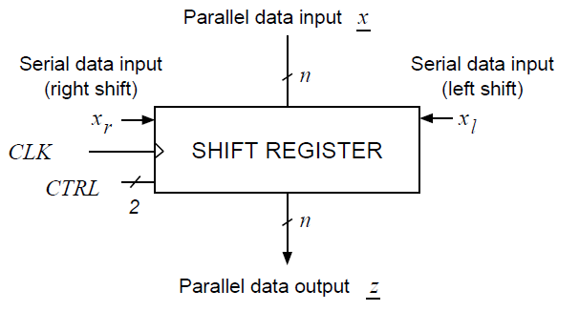
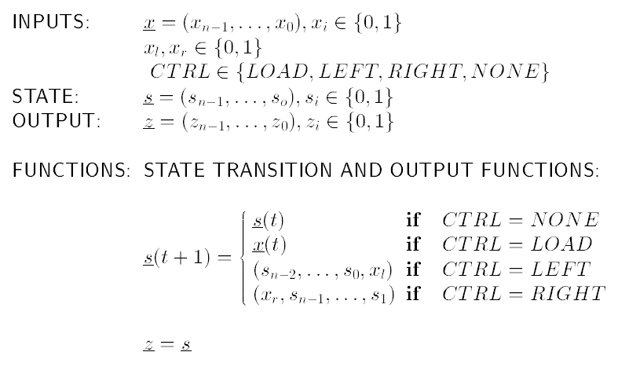
Shift registers

Slide 6
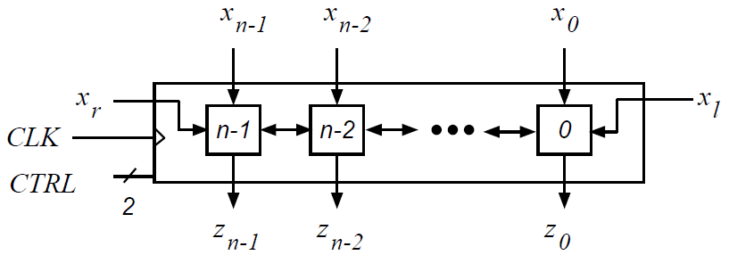
Shift registers

Slide 7
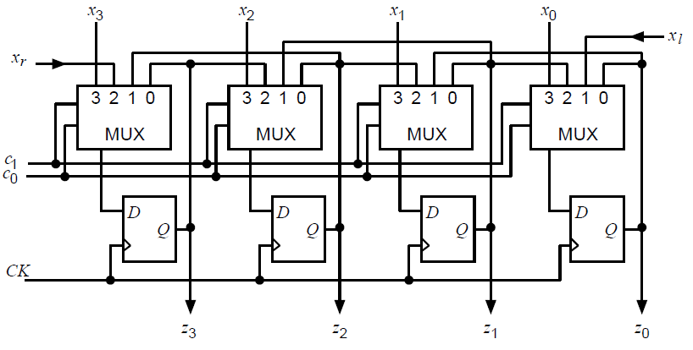
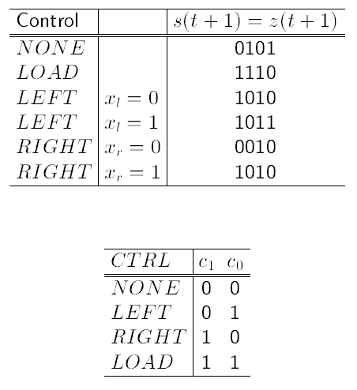
Shift registers

Slide 8
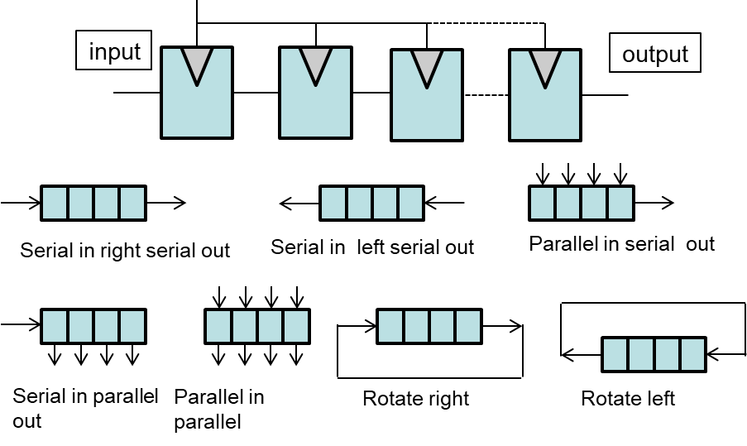
Register types

Slide 9
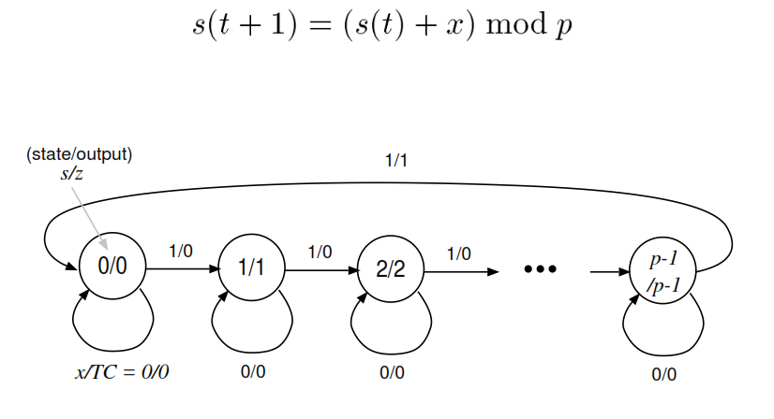
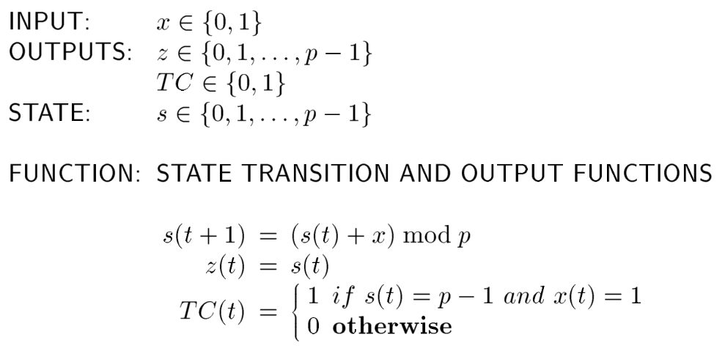
Counters

Slide 10
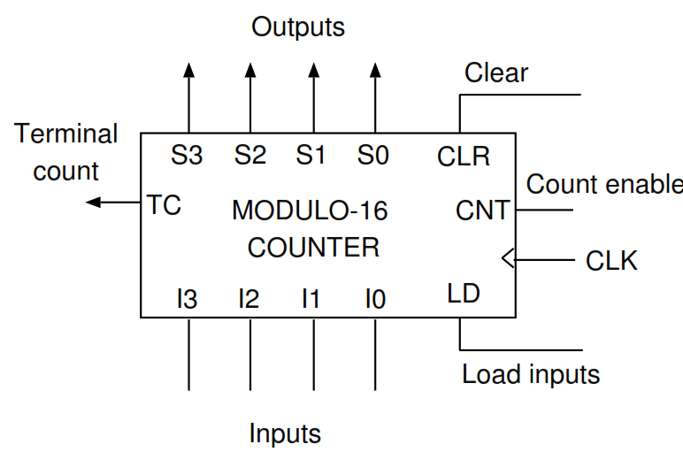
Counters

Slide 11
Memories: functionality
READ ONLY MEMORY (ROM, …)
READ AND WRITE MEMORY (RAM, FLASH,…)
VOLATILE: data lost when power is switched off (RAM,…)
NON-VOLATILE: data kept when power is switched off (ROM,FLASH,…)

Slide 12
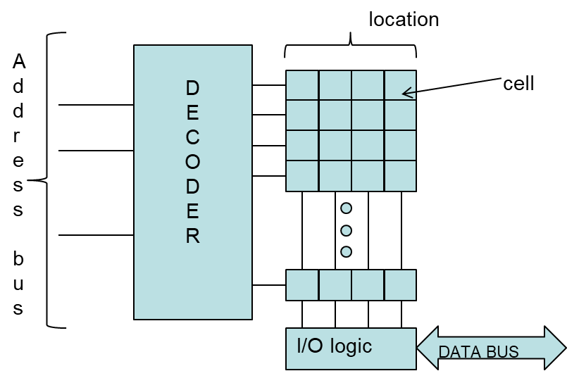
Memory architecture
wordlines
bitlines

Slide 13
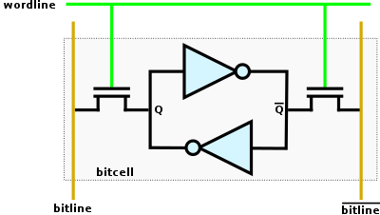
Static RAM (SRAM) cell
STATIC: no refresh is required
RAM (Random Access Memory): it is possible to access any memory location without limitation
CELL: basic storage element (1 bit)
It’s a volatile memory

Slide 14
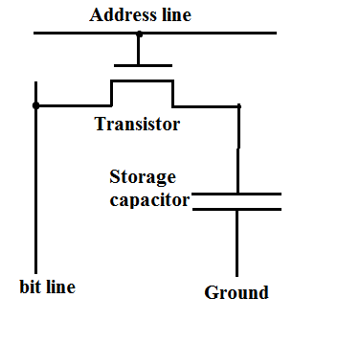
Dynamic RAM (DRAM) cell
DYNAMIC: refresh is required
Even when powered, the cell may slowly loose its value
A periodic refresh process memorizes again the value.
The level of charge on the memory cell capacitor determines the stored bit
The capacitor is usually implemented using the gate of a MOS.
The presence of charge in the capacitor indicates a logic "1" and the absence of charge indicates a logical "0".
It’s a volatile memory
It’s faster to access than SRAM

Slide 15
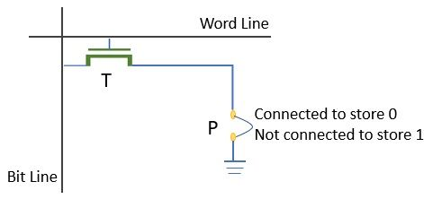
Read Only Memory (ROM) cell
Data is provided during the fabrication and cannot be updated
It’s a non-volatile memory

Slide 16
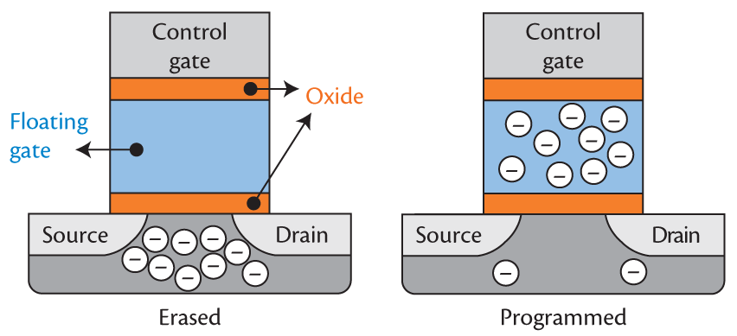
Flash memory cell
It’ a non-volatile memory but may loose its value slowly
Used in Pen-Drives, SD cards, SSDs,…
It has an additive layer of oxide in the MOS used to trap the charges
If a high voltage is applied to the control gate the electrons are trapped in the floating gate

